Slide 1
A cASE STUDY: EVALUATING A SELF-ACCESS CENTRE’s EFFECTIVENESS AND Efficiency
Daya DATWANI CHOY
The University of Hong Kong
DRAL2/ILA2014
14 June 2014

Slide 2
CONTENT
Context of Study
Data collection & Analysis
Implications
Methods
Problem & Research Questions

Slide 3
CAES Self-access since 1992
1992 Lab
1994 Independent Learning Centre
Meng Wah
Old Library
K.K. Leung
TEACHING ASSISTANT
PEER TUTOR
2013 Chi Wah Learning Commons Zone R
Integrated Science Course 2003
ELRC
2012

Slide 4
Problem of Practice
SIGNIFICANCE
SAC Coordinator & Tutors
Students
Administrators
The purpose of the case study is to discover the processes administrators and stakeholders use to evaluate self-access centers’ effectiveness and efficiency in a university in Hong Kong
Annual Report:
Administrative measures of accountability such as
number of users
tutor/student ratio is considered effective??

Slide 5
Research Question
Central question:
What processes are employed by administrators and stakeholders to evaluate the effectiveness and efficiency of a self-access center?
Sub-questions:
How do students & tutors experience the centre?
What additional learning experiences do they imagine would facilitate students’ self-efficacy for becoming an independent learner?

Slide 6
Effectiveness not Efficiency
Importance of measuring Effectiveness
Good and bad practices leads to development of learning materials and activities.
Effective teachers would encourage students to use SALL and expose them to a wider range of learning opportunities.
If SALL is seen to be effective more learners would want to make use of it. (Gardner & Miller 1999 p.231)
“Evaluation can be defined as the systematic gathering of information for the purpose of making decisions” Weiss 1972

Slide 7
Research Strategy
TRIANGULATION
The interpretive paradigm aligned with a qualitative approach because of its sociological elements best fits the study
Close collaboration between the researcher and participant result in constructivism built upon the social construction reality.
MANAGEMENT REPORTS & INTERVIEW
STUDENTS’ QUESTIONNAIRE
INTERVIEW
TEACHERS’
FOCUS GROUP

Slide 8
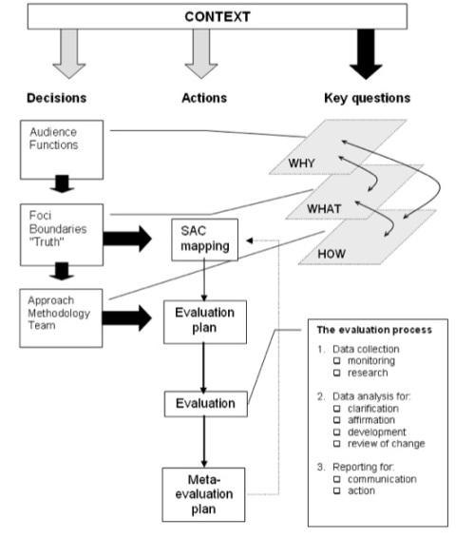
Theoretical Framework
Morrison (2011) A Framework for the “Evaluation of Self-access Language Learning Centre” would be adapted.
Two reasons an informed framework for the evaluation of SACs is needed
Central to the development of SALL as much literature mentions SACs and its future development.
Funding bodies often require demonstrable accountability from a more summative perspective rather than simple checks and balances from a budget-focused accounting.

Slide 9
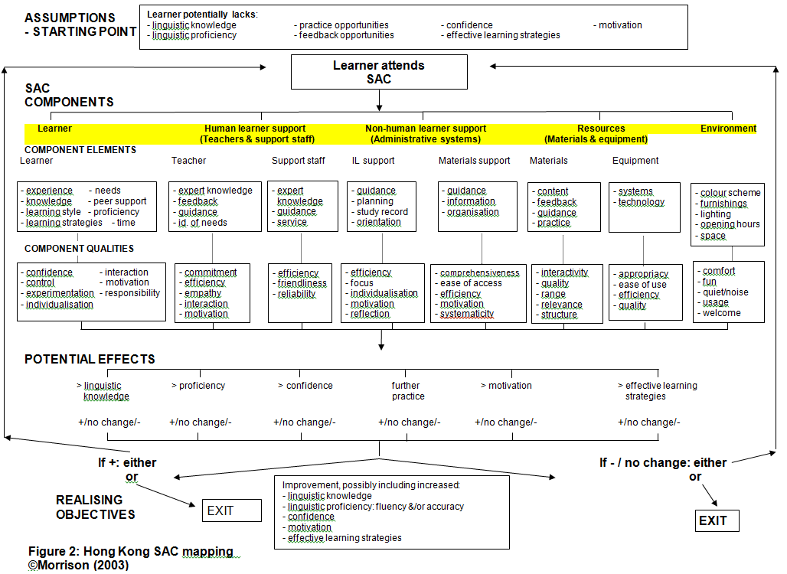

Slide 10
LITERATURE REVIEW
Step 1: Keyword search
Self-access Language Learning (SALL),
Self-access Centre,
Self-directed learning (SDL)
Language advising / counselling
Evaluating learner gain / learner autonomy
(exclude: learner autonomy, independent learning)
Step 2: Year 2000 to current research
Step 3: Classified major themes
Learning environment (facilities, resources, hardware and software)
Tutor or adviser practices and relationships
Learner motivation and students’ perception (L2 self, metacognition)

Slide 11
Learning environment (facilities, resources, hardware and software)
Gardner & Miller (2010)
Gardner (2011)
Morrison (2011)
Tutor or adviser practices and relationships
Karlsson, Kjisik and Nordlund (2007)
Mozzon-McPherson (2000, 2007)
Learner motivation and students’ perception (L2 self, metacognition
Dornyei (1994, 2009)
Dornyei & Ushioda (2009)
Murray (2011)

Slide 12
Environment
Physical & Virtual
Tutor or Adviser practices and relationship
Motivation
& Students’ perception

Slide 13
Research Design – Site and Participants
Total student population 27,005 | Taught & Research Postgraduate 11,778 (43.6%) | Undergraduate 15,227 (56.4%)
over 9,000 non-local students from 80 countries
2/3 from China 1/3 other countries (HKU Review 2013)

Slide 14
The Centre for Applied English Studies
Established in 1992 provides English support to undergraduates at HKU.
We now offer thesis writing and academic language instruction to postgraduate students and conducts research into academic discourse and literacy practices in various domains

Slide 15
Research Design – Site and participants
Unit of Analysis – Embedded 3 Units
1. Students
On line questionnaire via email to all student users Year 2013-14
Students volunteer for semi-structured interviews
Purposeful criterion sampling:
Age 18 or above
English as a second language learner (ESL)
email ensure that participants identity under protection, interviewees pseudo named or coded
2. Tutors/instructors
Mini focus group 6-7 tutors
Purposeful criterion sampling:
Only involved in SAC work
Recruitment: via email to all SA tutors running workshops, discussion groups and advising
3. Administrators & Managers
Annual reports and documentation
Interview Associate Director
Interview SAC coordinator

Slide 16
CONCEPTUAL FRAMEWORK
QUESTIONNAIRE TO ALL STUDENT USERS IN THE SEMESTER
SEMI-STRUCTURED INTERVIEW
INTERVIEW SAC COORDINATOR & DOCUMENTATION
SAC TUTORS
FOCUS GROUP
Research Design - Data collection

Slide 17
Research Design - Data Analysis
Five-step analysis process (Creswell, 2013).
Generating overall impression of participants’ responses
Identifying significant phrases within participants’ responses
Transforming significant statements into categories and clusters of meaning with different themes
Interpreting the results into thorough and exhaustive description of the phenomenon
Clarifying the findings with participants and inviting their remarks and comments
Four forms of interpretation and data analysis Stake (1995).
Catergorical aggregation by seeking instances of meaning emerging from data
Direct interpretation from a single instance by drawing data apart and reconstructing them in more meaningful ways
Correspondence and Patterns by searching for patterns of consistency
Naturalistic Generalisations are conclusions arrived at through real life experience that can be applied to new case studies

Slide 18
Research Design - Trustworthiness
TRIANGULATION
Triangulation
Internal consistency and generalizability of findings
Member checking
Focus groups transcripts were sent to tutors for confirmation
Thick description
Findings from students / tutors will be collated with management responses for further interpretations
MANAGEMENT REPORTS & INTERVIEW
STUDENTS’ QUESTIONNAIRE
INTERVIEW
TUTORS’
FOCUS GROUP

Slide 19
Data Collection Spring academic year 2013/14 | Details
Week 12-13 (End Apr.2014) | Administer students’ online questionnaire
Revison & Exam Period (May 2014) | Semi-structured students’ interviews
Week 12 | Tutors mini-focus groups
June 2014 | Administrator and SAC coordinator interviews Review Annual report
 | Follow up questions (if any) data analysis, member check

Slide 20
Data collection
Research Instruments | No. of Participants | Type of Data
Student questionnaires sent to 1230 SAC users last week of Semester 2 2013-4 (End Apr. 2014) | 65 students | 21 Questions Quantitative: Likert scale items Qualitative: Open-ended
Semi-structured interviews Volunteer (during exam / revision period May 2014 | 15 students | Qualitative
Tutors Focus Group (End Apr.2014) End of Semester (emailed 11 Tutors) | 7 Tutors | Qualitative
Interview Associate Director |  | Qualitative
Interview SAC coordinator |  | Qualitative
SAC Annual Report (2012-3 & 2013-4) | 2 years | Documentation

Slide 21
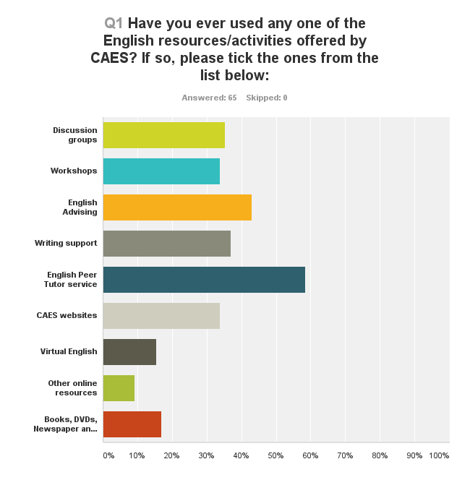

Slide 22
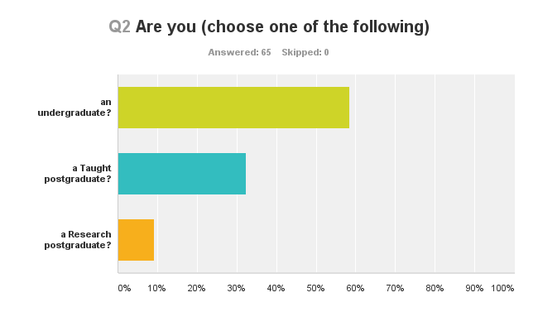
58.40% (38)
32.31%
(21)
9.23%
(6)

Slide 23
Tutors Focus Group
Research
Postgraduates
Tutor | Discussion Group | One-to-one consultation | Workshops | Writing Support
T1 | Sem 1 & 2 | Sem 1 & 2 | X | X
T2 | X | Sem 1 | X | X
T3 | X | Sem 1 & 2 | X | X
T4 | Sem 1 | Sem 1 | X | X
T5 | X | Sem2 (6 wks) | Sem 2 (6wks) | X
T6 | X | X | X | X

Slide 24
8 Undergraduate 5 Taught Postgraduate 2 Research Postgraduate = 15
Student | Discussion Groups | One-to-one Lang. Advising | Workshops | Writing Support | Peer Tutoring | Virtual English | Books
S1 |  | √ | √ | √ |  | √
S2 |  |  |  |  | √
S3 | √ | √
S4 | √ | √
S5 | √ | √ | √ | √ | √ | √ | √
S6 |  |  |  |  |  | √
S7 |  |  |  | √ |  |  | √
S8 |  | √ |  |  | √ 5
S9 |  |  | √ |  | √ 3 | √
S10 | √ |  |  |  | √ 4
S11 | √ | √ | √ | √ | √ | √
S12 | √ | √ | √ | √ | √ | √ | √
S13 |  |  |  |  | √
S14 | √ | √ | √ |  | √ | √ | √
S15 |  | √ |  |  |  | √ | √

Slide 25
Tutors perspective - Success
“when students learn something from the consultation and discover something that is useful”
“when they don’t want to leave and want to go on discussing (DGs)”
“when the students know what they want when they come and get out of a session”
“more fulfilling working with the PhD students”

Slide 26
Students’ perspective - Success
“my pronunciation was much better than Y1… the adviser gave me some acknowledgement about my pronunciation because I achieved that stage… I want to move on to be more native-like and then building on the acknowledgement he gave me some more advise on improving my own accent.
The kind of acknowledgement and how he build on that foundation gave me some more confidence in studying in English”

Slide 27
Tutors’ perspective – anxiety and frustrations
“because it has nothing to do. about improving English or anything. I felt bad after the session” (personal statement views)
“wanted to improve her speaking but she hates English and she hates English culture hadn’t really thought about English going beyond her experience in academic English”
“comes in every week with translation work…let’s not look at any more writing let’s work on the issues that keep coming. She was not happy about that…My heart sinks when I see her”

Slide 28
Students’ perspective – anxiety and frustrations
“In a discussion group….the facilitator…guess she was a teacher…it seems focused too much on the negative side of every person there…so I didn’t feel good…
For example like (prompt)
I still remember actually she said “Oh you’re majoring in English then you must work hard” something like that because at the time I was a bit bad and I knew it as well”

Slide 29
Tutors’ perspective
Mainland China
More Motivated
Rote learning
More aggressive in Discussion groups
Local students
More pragmatic
Do not like coming to discussion groups too many mainlanders
“lot of Mainland students like 9 out of 10”
“maybe that language seems to be the way the key to assimilating with the culture”

Slide 30
Students’ perspective – Cultural issues
S5 “Yes because sometimes maybe I want to talk about something related to cultures. Like the western culture but it seems some of them…well I’ve just been there twice both tutors…it seems they did not know about the western culture that much.” (peer tutoring)
S14 “I stutter and I go through the sentences in my mind over and over again. “Did I pick the right word?” especially talking with native speakers but now it’s much better.”

Slide 31
Tutors’ perspective – need more information
“Marking rubrics/criteria from other departments so we know what is expected”
“More information about students in order to prepare”
“Specific questions from students”
“This point highlights the clash that points that we should be teaching strategies rather than fixes”

Slide 32
Students’ perspective – both sides (user & peer tutor s14)
“when I mentioned what I would like to achieve and I’m a bit concerned how I’m not able to do it…as of now…and I remember I was told by the tutor that many native speakers wouldn’t be able to do it freely as spontaneously as the kind of skills I want to achieve”
“I would wish by the time I was having problems like that someone would have been there to tell me oh..this is the case and you know…not just you should think of language this way but rather the idea is more important”

Slide 33
Virtual English
S14 “I think all those resources CAES has listed on the VE website all this kind of information represents about less than 1% of the resources that you can find online… I mean as far as language learning goes”

Slide 34
Tutors perspective – motivation
“different mode of teaching… been in the classroom so long, it’s good to go out and interact with students one on one”
“motivates myself to explore different resources because got fed of myself introducing the same resources all the time”
“we have to believe in the effectiveness of independent learning” T5
“change their attitude of learning English by themselves” T6

Slide 35
Motivating factors for students use SAC services or resources
Teachers’ perspective
English for Free
that they need more of a sense of community
Psychological support some mental support
No proofreading
Students’ perspective
English for Communication
Clear sense of purpose:
Speaking or writing
Moral support to gain confidence
“This point highlights the clash that points that we should be teaching strategies rather than fixes”

Slide 36
Administrators’ Perspective
SAC Coordinator
ASSOCIATE DIRECTOR
Annual Report
Role has become more complex
No administrative support
University Grants’ Committee
English Enhancement Fund
Need for core team (timetabling issues)
Teachers’ belief & attitude
Integrated into Science Course
Teaching Assistant – TDG project
CEDARS – Peer tutoring
Makes decision on new projects recommended by SAC Coordinator

Slide 37
Decision making Theory for Effective Policy & Practice
When resources are scarce, “decision-making systems are another structural source of potential power” (p.549).
Strategic Contingencies Theory in terms of horizontal power, subunits are most powerful when they are least dependent on other subunits (Hickson et. al in Bess & Dee (2008))
SAC as a subunit serves most of the four key contingencies:
Scarcity Uncertainty Centrality to Nonsubstitutability
the workflow

Slide 39
Conceptual Framework – SAC Evaluation
KAIZEN - CONTINUOUS IMPROVEMENT
HUMAN
SUPPORT
LEARNERS
RESOURCES
ADMINISTRATIVE/IT SUPPORT
FEEDBACK & STORIES OF SUCCESS
TRAINING & SHARING

Slide 40
Implications
Limitations:
One site
Formative evaluation
Student population
Further Research:
Other SACs (HK & Globally)
Managers’ Beliefs
Longitudinal study
(after graduation)

